Slide 1
Algorand On-Chain Image
Cameron Durbin

Slide 2
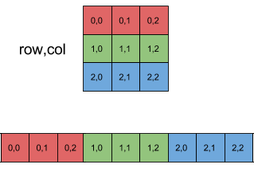
What is it?
An 100x100 image that lives inside the blockchain.
The HEX value for each pixel is written in blockchain memory.
This implies that the blockchain must have some sort of memory architecture.
This also implies that the blockchain must have a read-write mechanism for interacting with the pixels.

Slide 3
Pros and Cons of an On-Chain Image
Pros
Transparency (if you know the contract IDs)
Security
Cheap interactions
New
Cons
Expensive to create (60 Algos)
Dangerous

Slide 4
How it works?
We use 20 smart contacts
Each contract contains 50 byte arrays
Each byte array contains 10 pixels
Each pixel is represented as an RGB value.
Number of pixels:
20 * 50 * 10
= 10,000
= 100 * 100

Slide 5
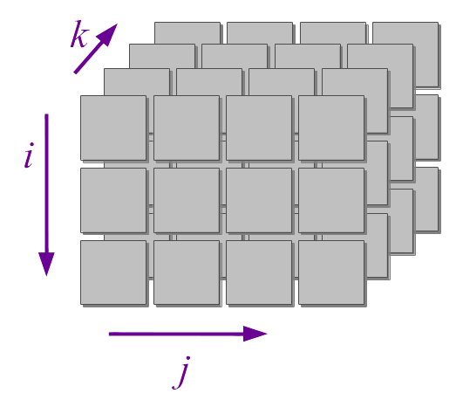
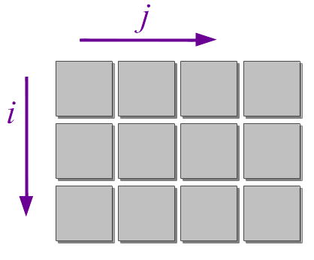
How it works?
Stored in 3D
Viewed in 2D
Smart Contract Logic
20 * 50 * 10 = 10,000
100 * 100 = 10,000
i - Contract Index
j - Byte Array Index
k - Pixel Index
i - Row Number
j - Column Number

Slide 6
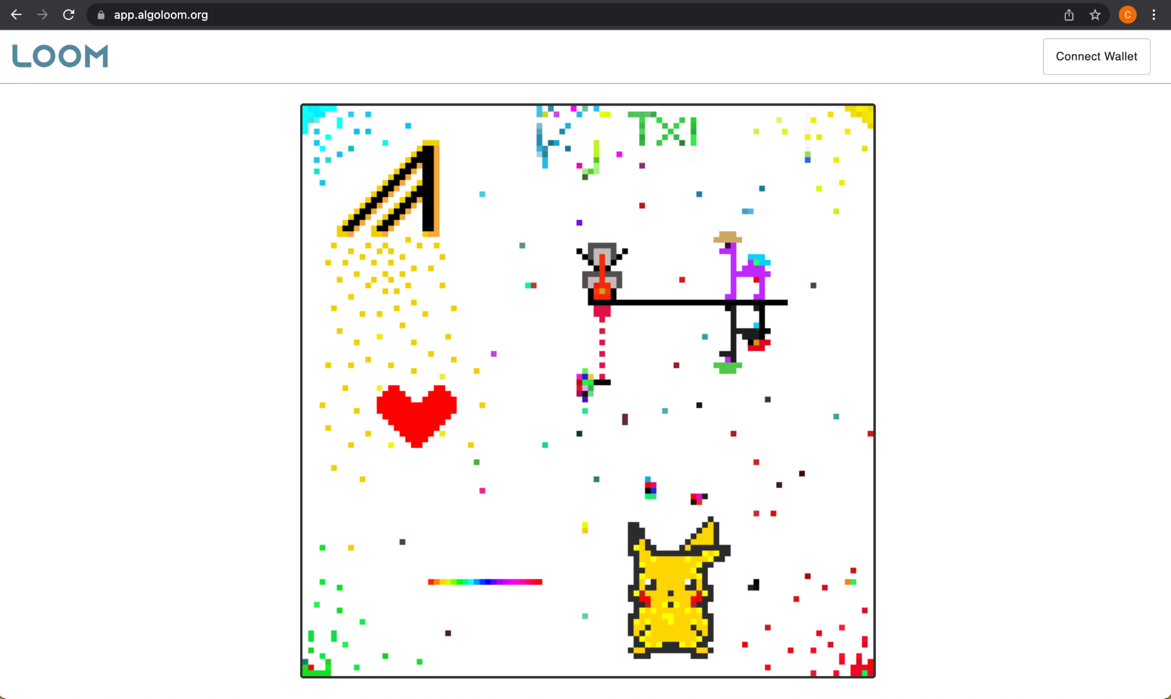
Example
app.algoloom.org
Connect wallet
Click on a pixel
Change color
Submit transaction

Slide 7
Let’s make it!
Github repo: https://github.com/PlatinumCD/AlgorandOnChainImage

